Slide 1


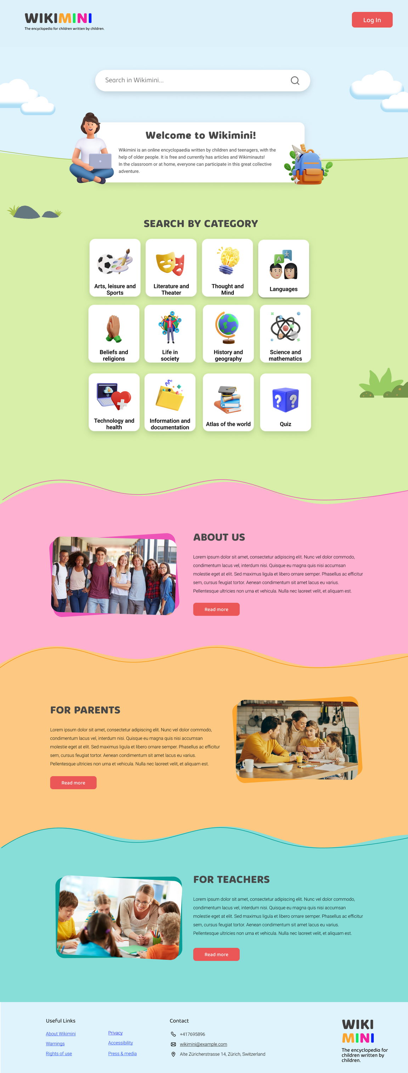
By THE MEDIAKIWI TEAM

Slide 2
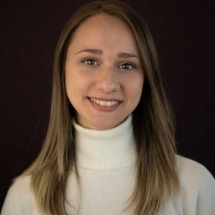

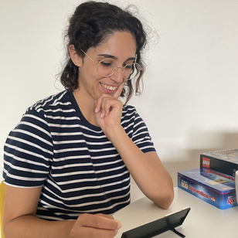
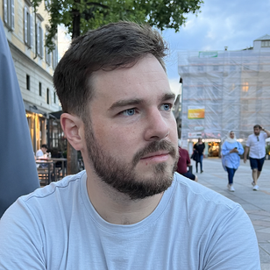
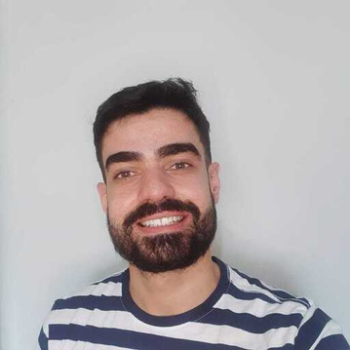
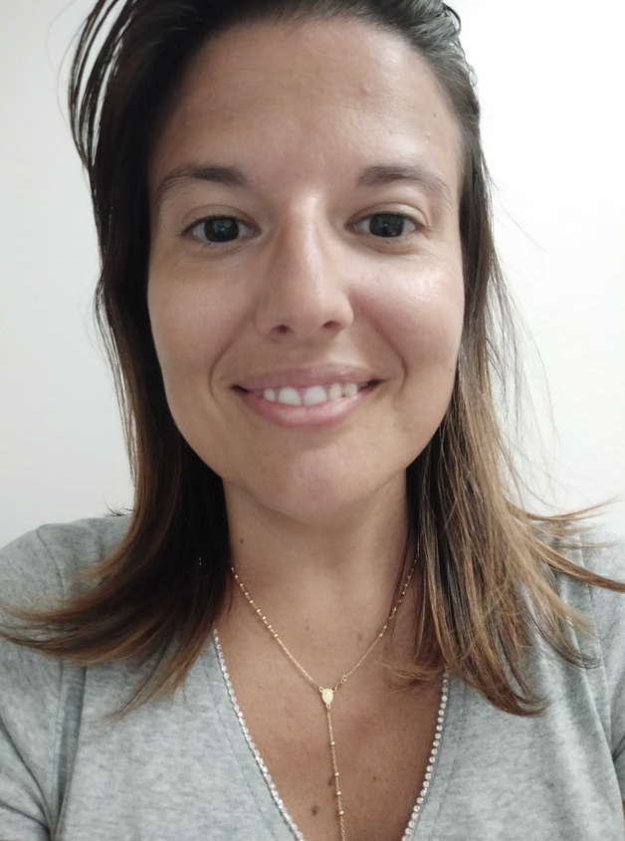
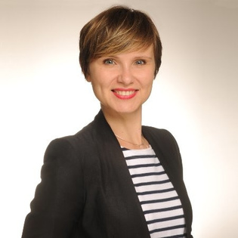


THE MEDIAKIWI TEAM
Valentina
Amanda
Soraia
Vicente
UX/UI Designer
Front-End Developer
Back-End Developer
Full-stack Developer
Leonardo
Rosaria
Varia
Front-End Developer
Deputy Project Manager
Project Manager

Slide 3
TEAM LEARNINGS
UX/UI handover to developers
Organisational skills
Front-End
UX/UI design
Work in a team
React
GIT/
Github
Take
ownership
Mediawiki
extensions
Technical knowledge
Time management
Collaboration
Mediawiki software
Working in agile mode
Back-End
Microsoft Azure
Better understanding of developer's language
Accept other opinions
Miro
Listen ideas and points of view with no prejudice
PHP
Understand business requirements
Figma
Communication skills
Slack

Slide 4

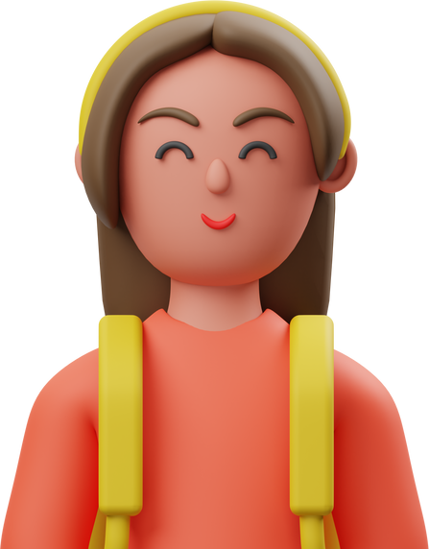
THE PROBLEM
WikiMini's site is not adapted to the current standards of the educational system
Lack of motivation to use the platform.
Uneffective workflow between teachers and students.
Old design and hard to understand.
Lose motivation to use the Wikimini site
Migration to other platforms

Slide 5


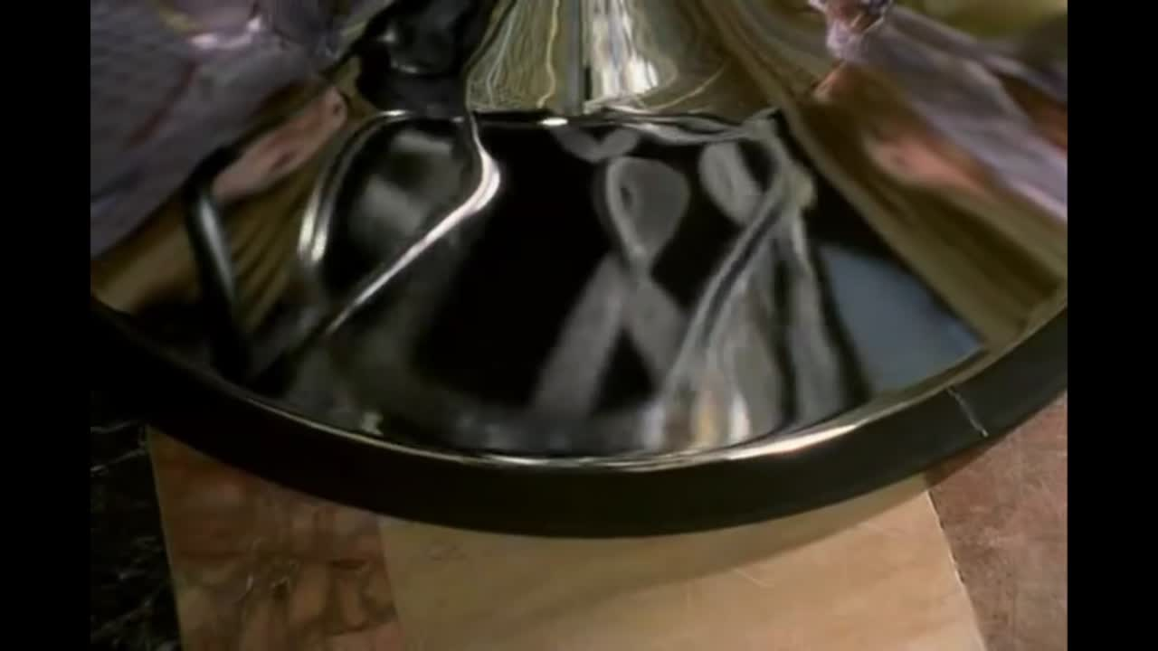
OUR SOLUTION

Slide 6

And now... talking seriously
New workflows adapted to current needs
Simple and intuitive design
Thinking in a reusable long-term solution
New features to make every user's life easier

Slide 7

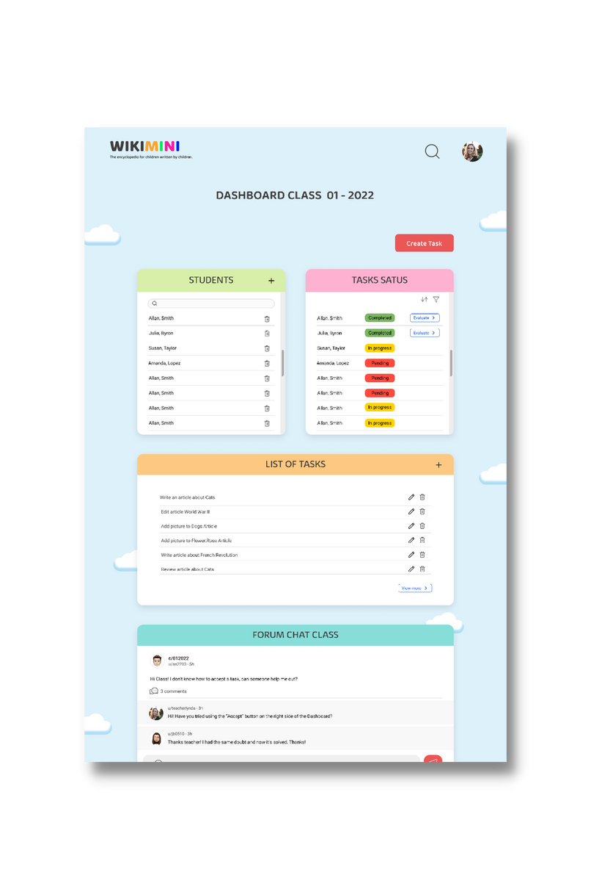
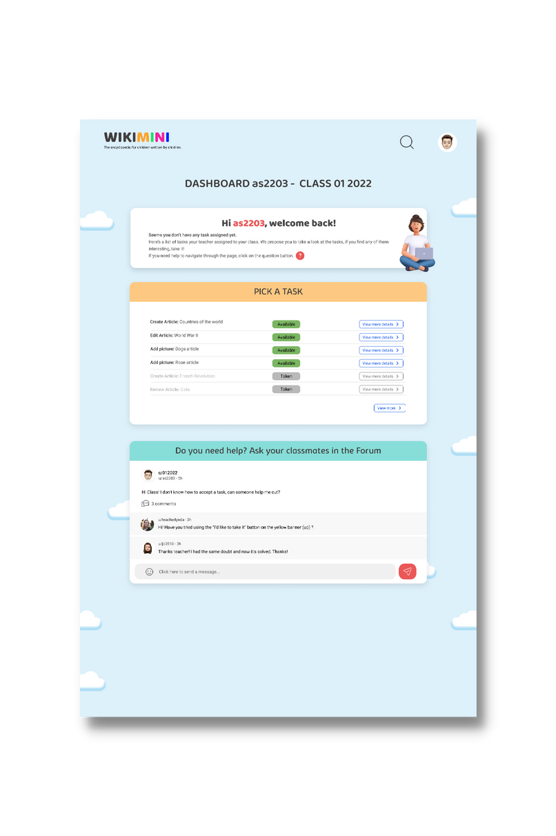
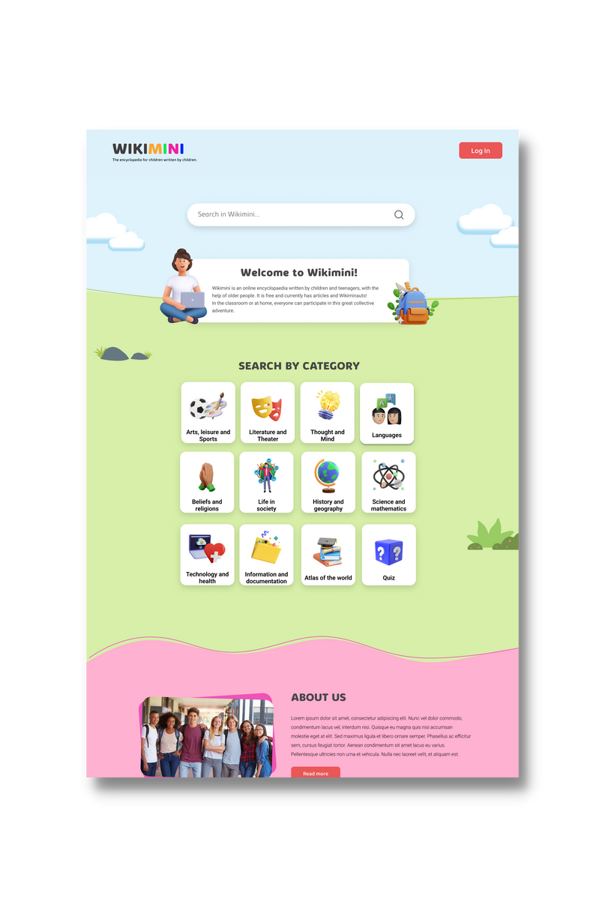


Let's dig in a little bit more...
Homepage & Article Page
Teacher Workflow
Student Workflow

Slide 8

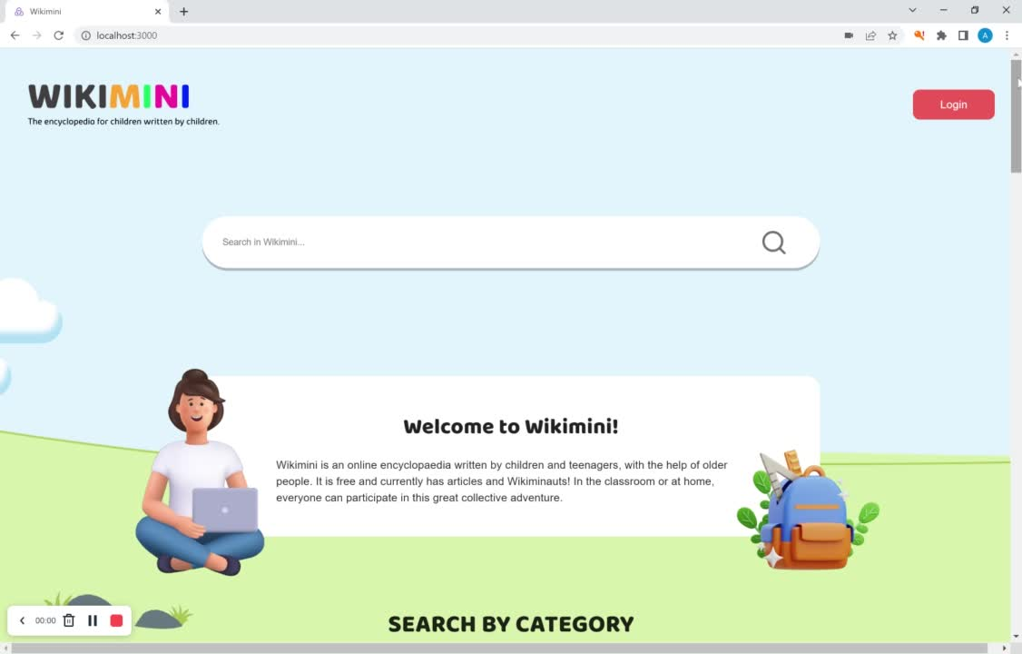
Homepage & Article Page
And this is the real frontend development!!

Slide 9
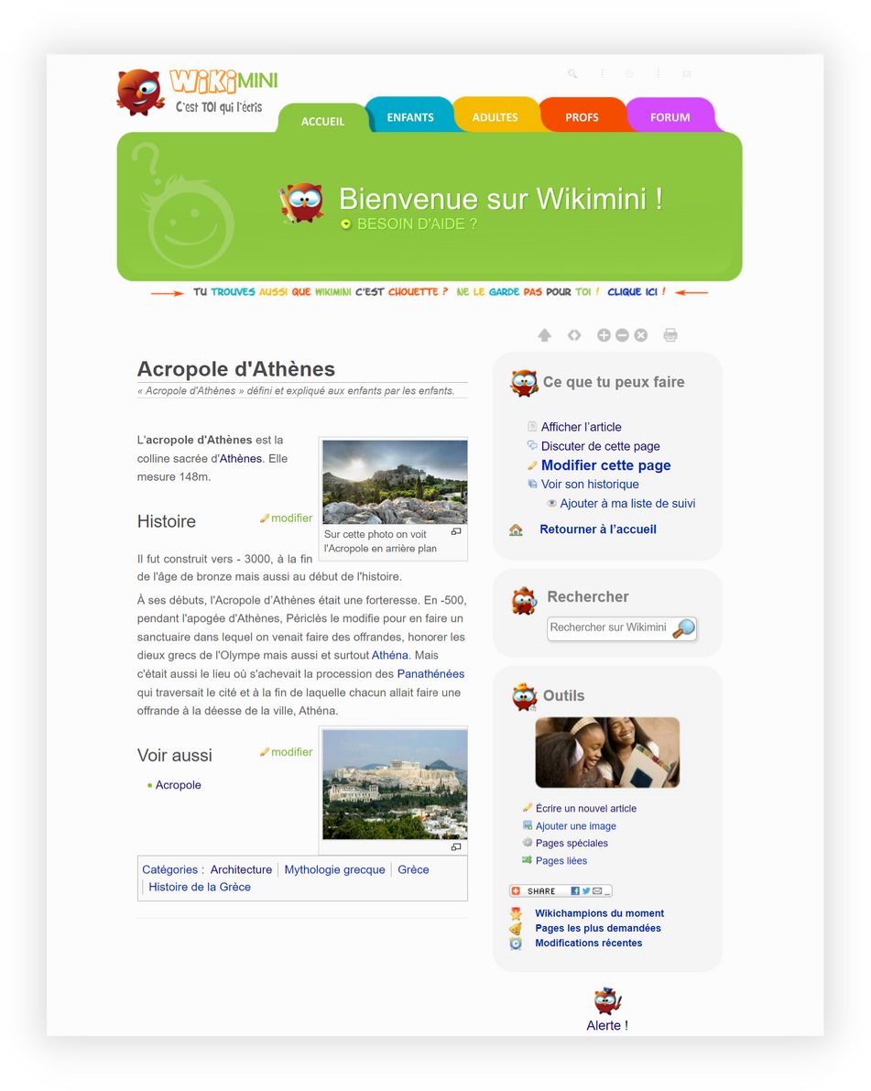
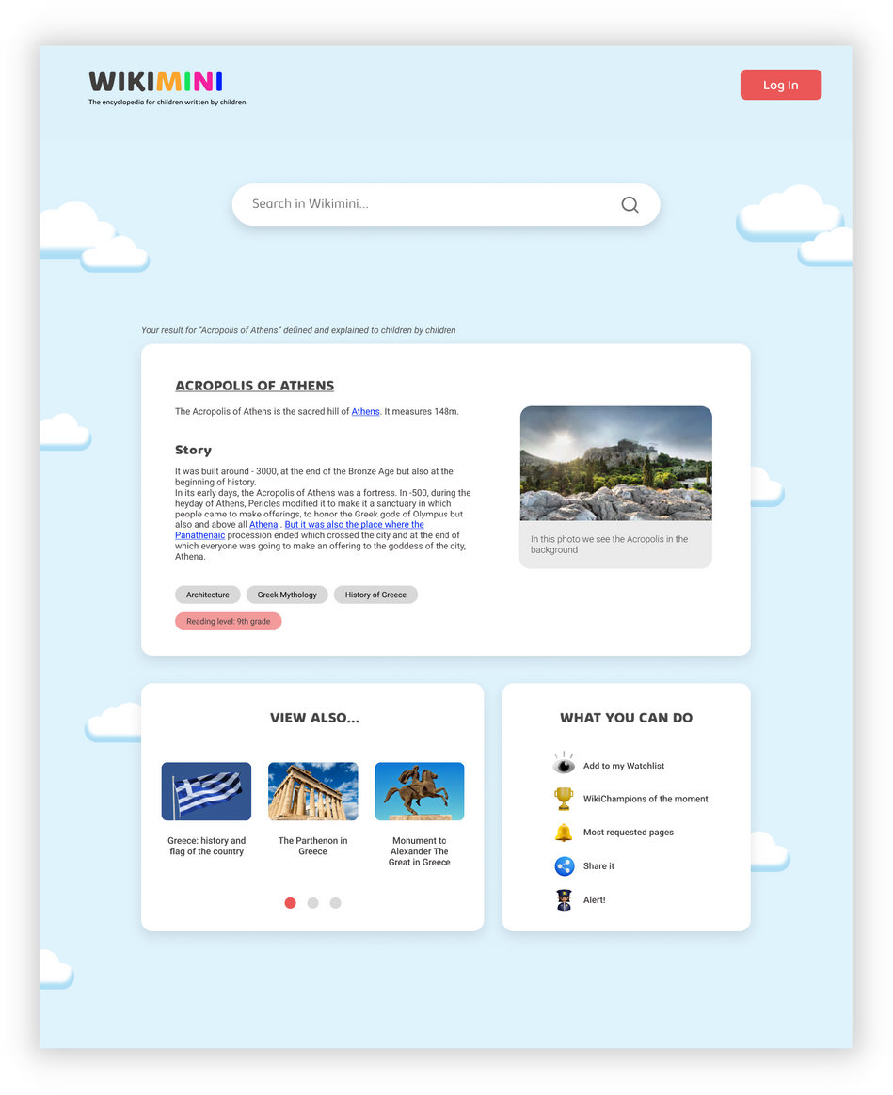
Article Page
Actual Article Page
Our proposal

Slide 10

Teacher Workflow

Slide 11
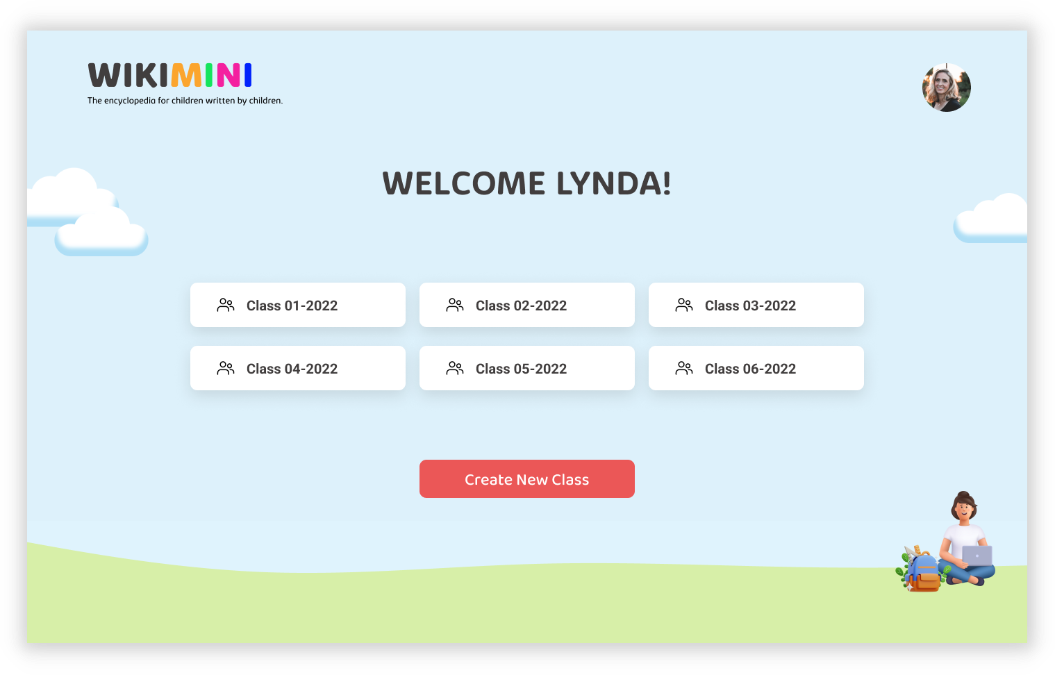
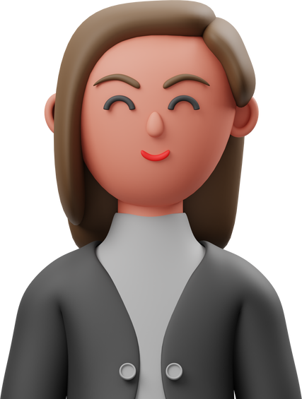

Teacher Workflow
Teacher

Slide 12
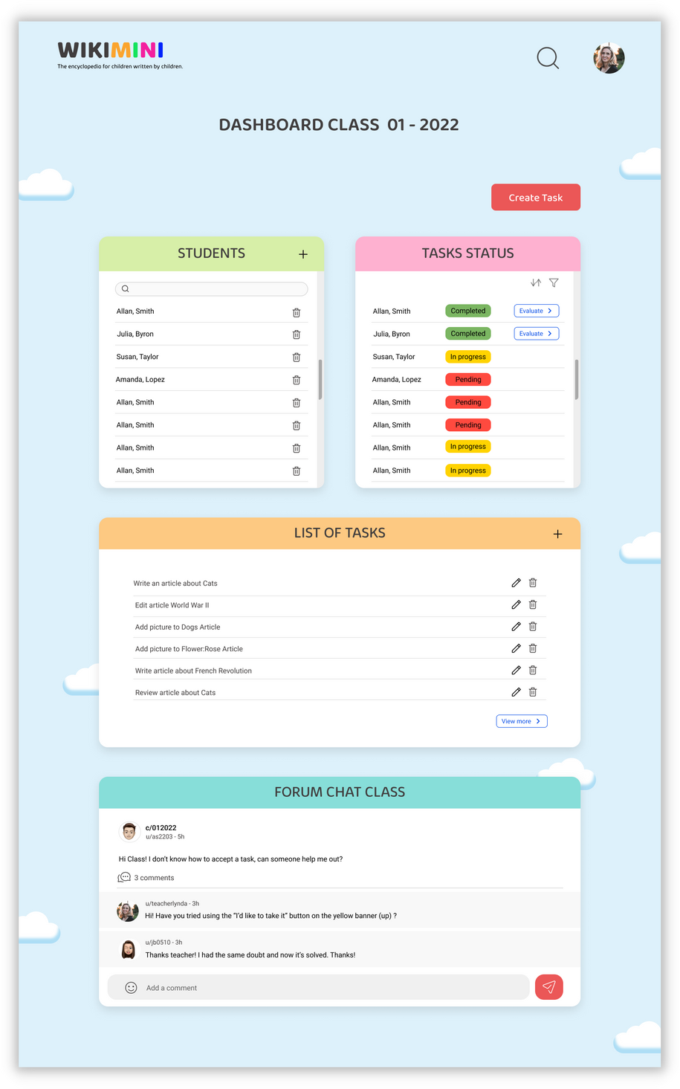
Teacher Workflow

Slide 13
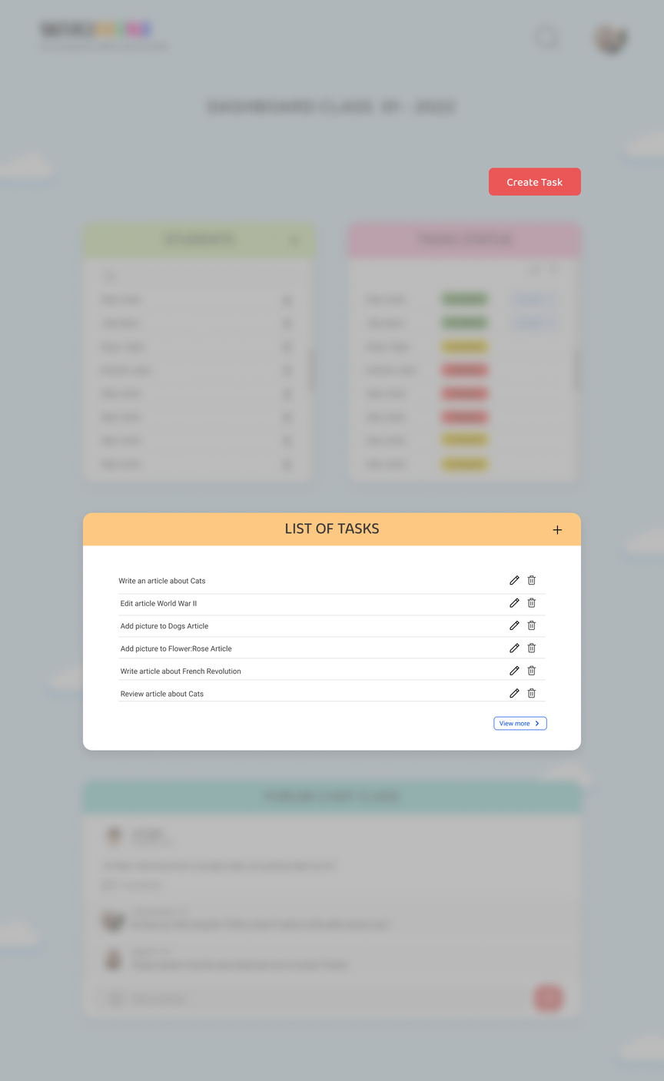
Teacher Workflow

Slide 14
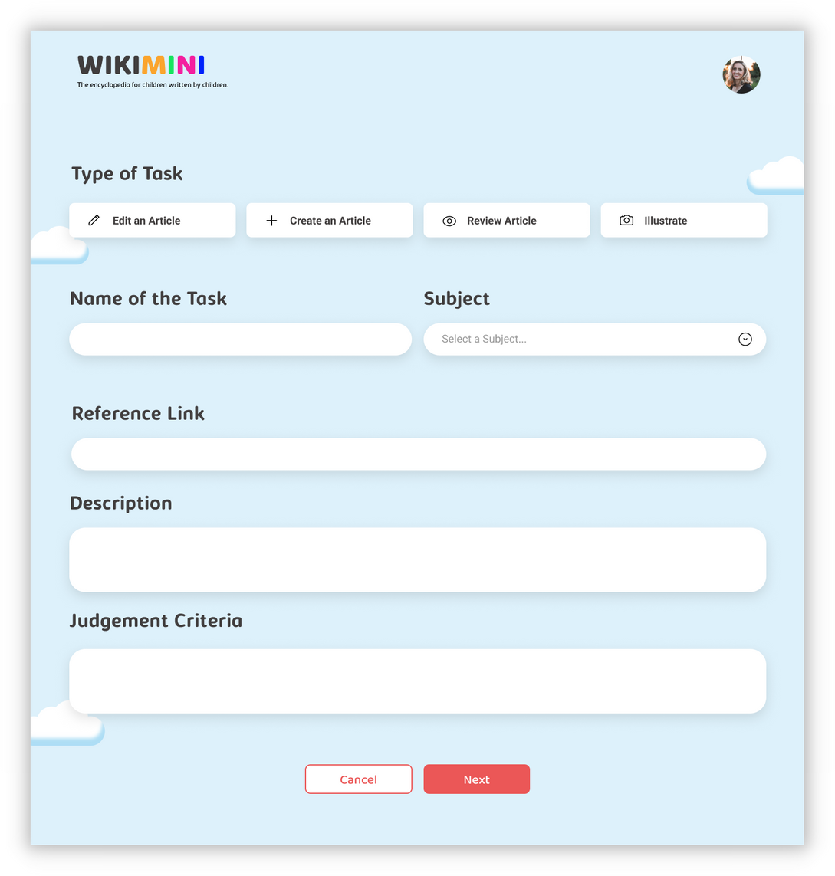
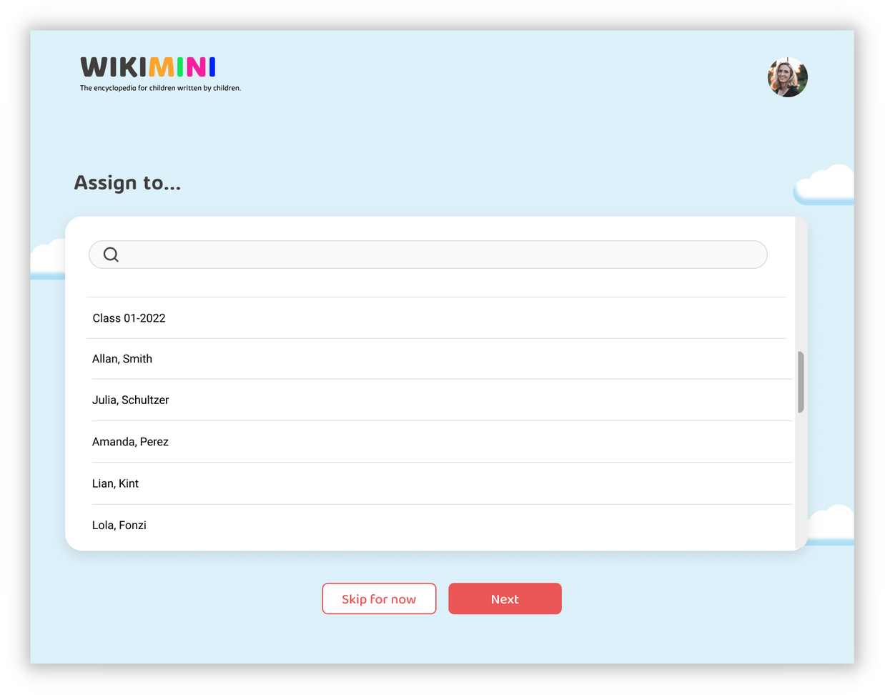
Teacher Workflow

Slide 15
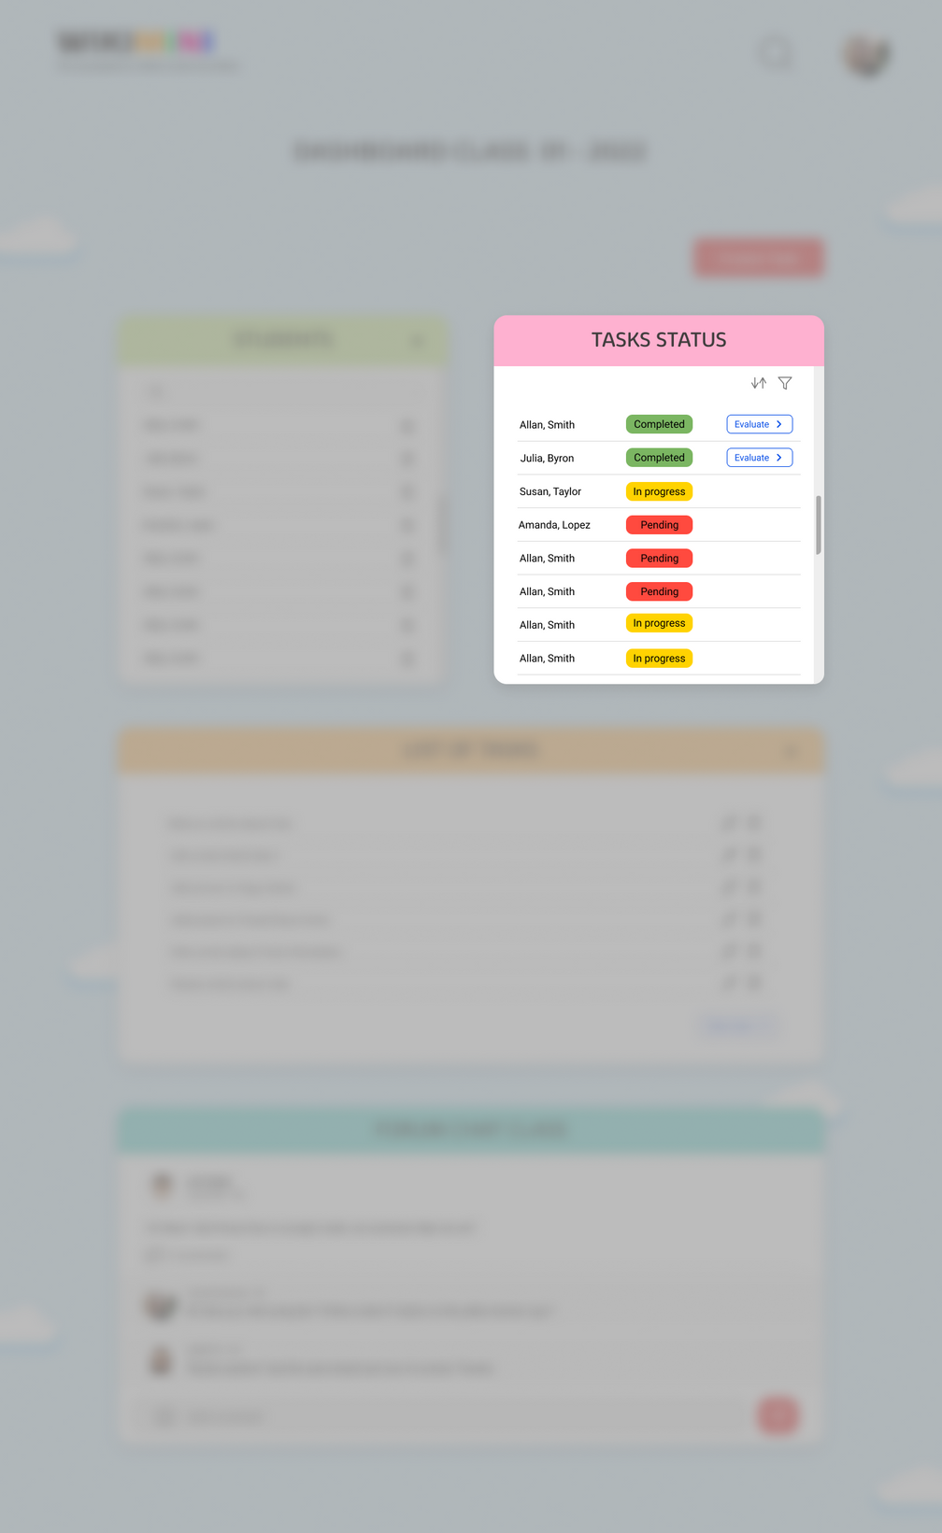
Teacher Workflow

Slide 16
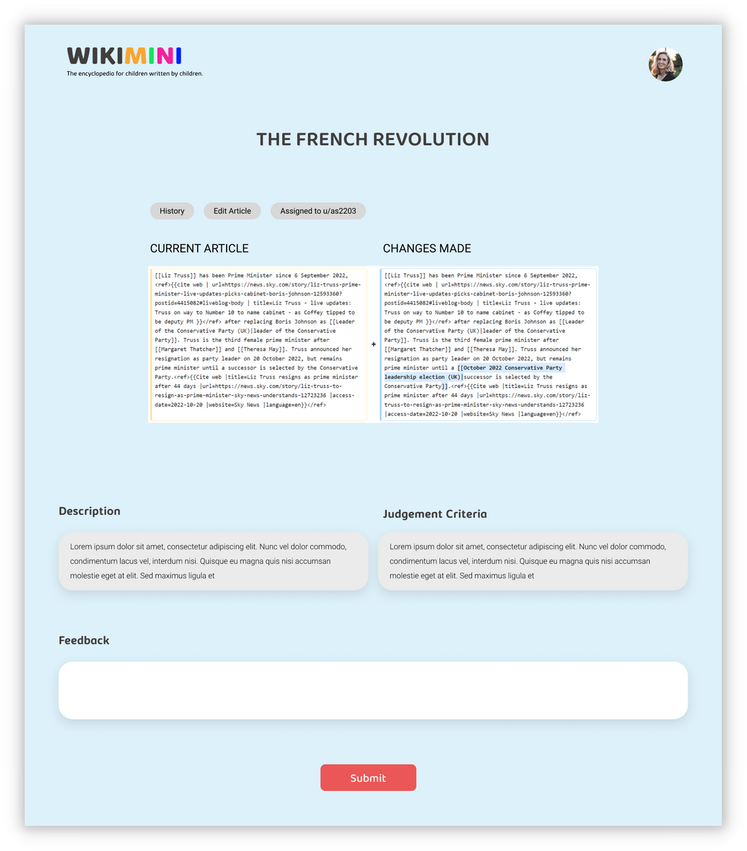
Teacher Workflow

Slide 17
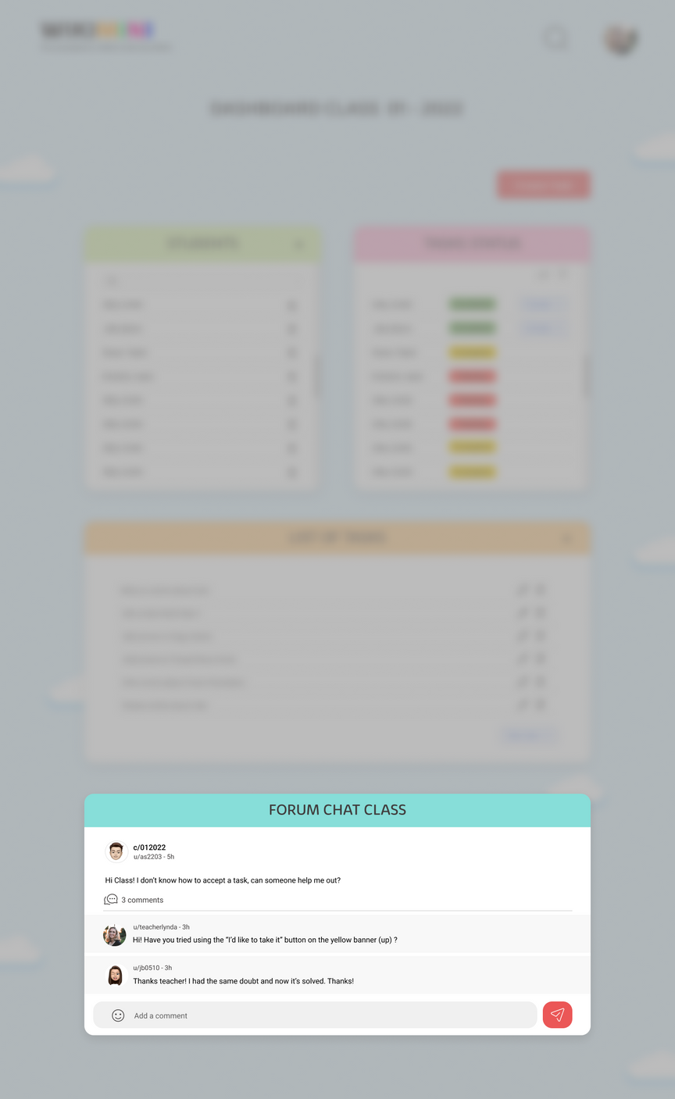
Teacher Workflow

Slide 18

Student Workflow

Slide 19
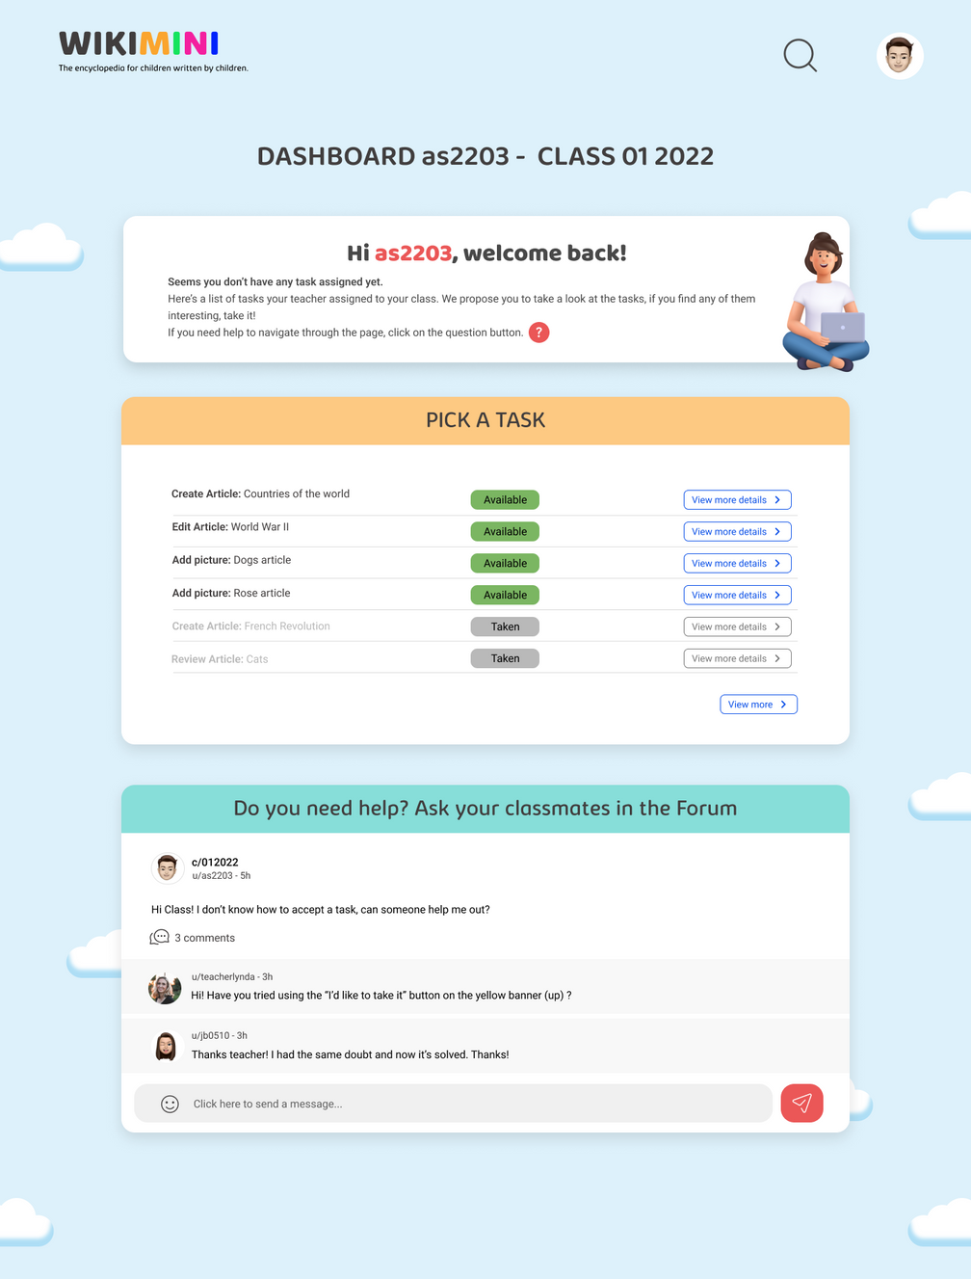
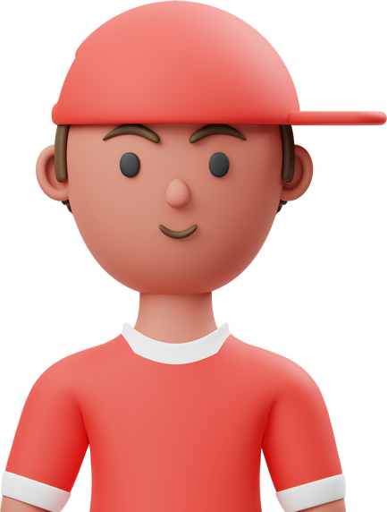
Student Workflow

Slide 20
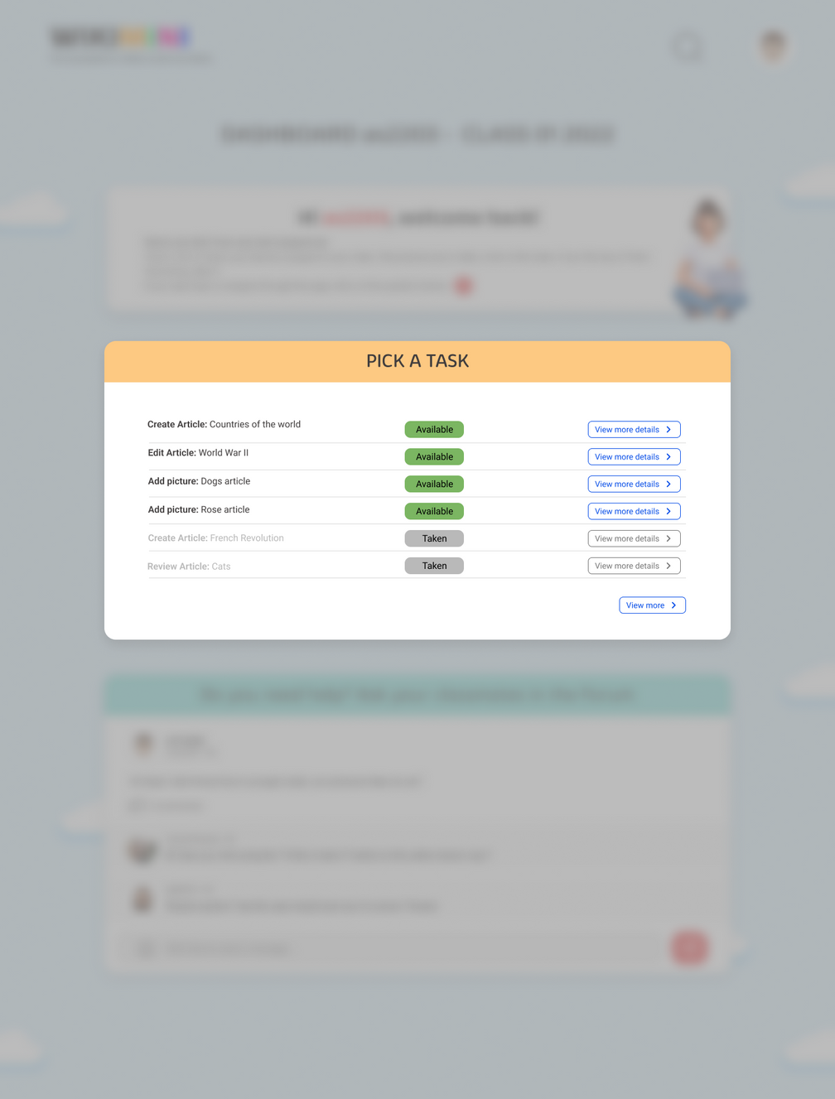
Student Workflow

Slide 21
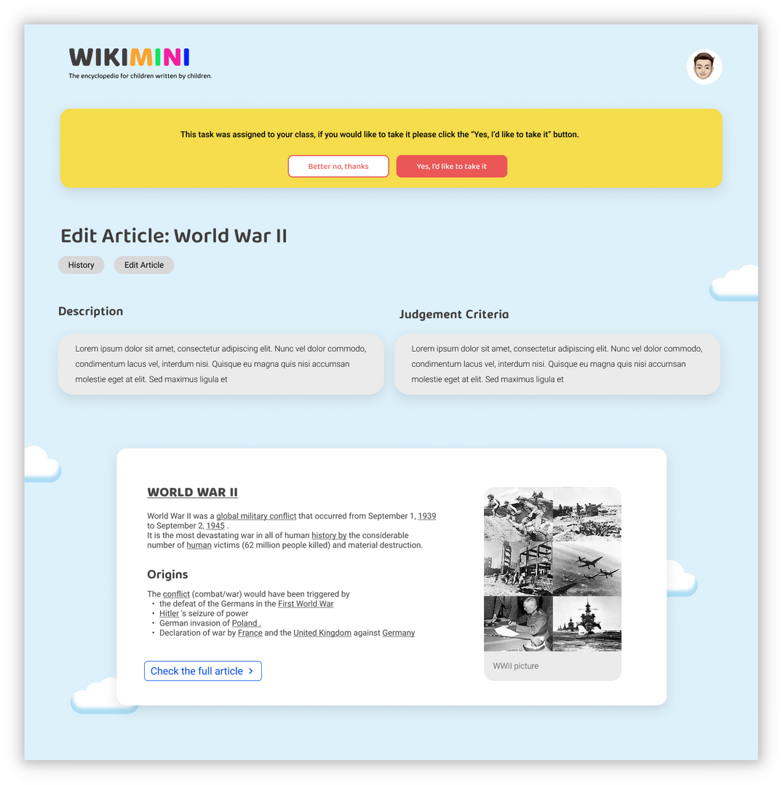
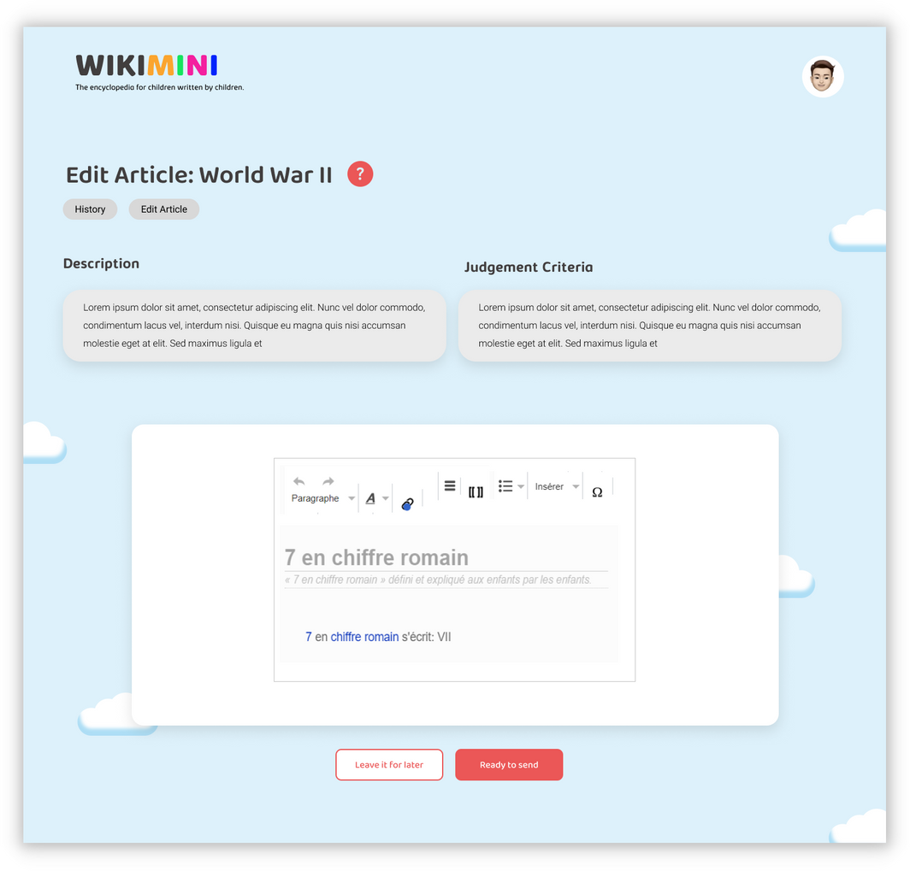
Student Workflow

Slide 22
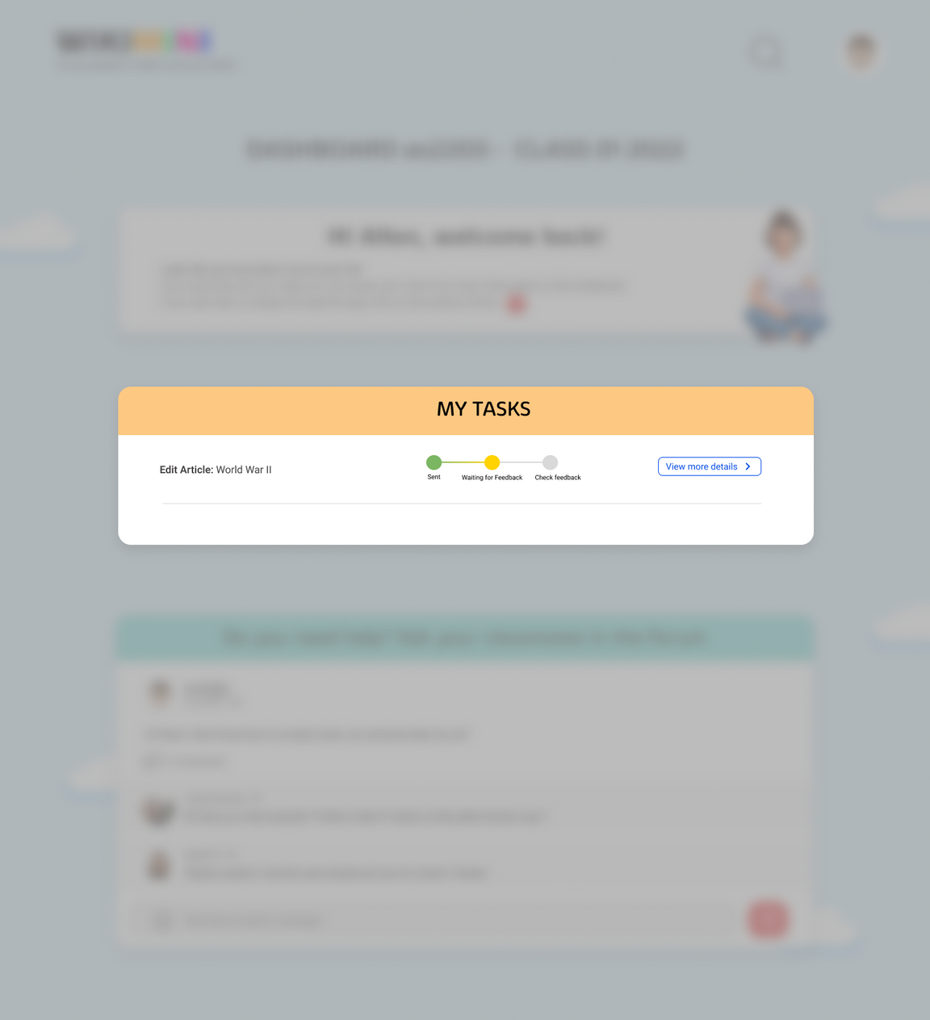
Student Workflow

Slide 23
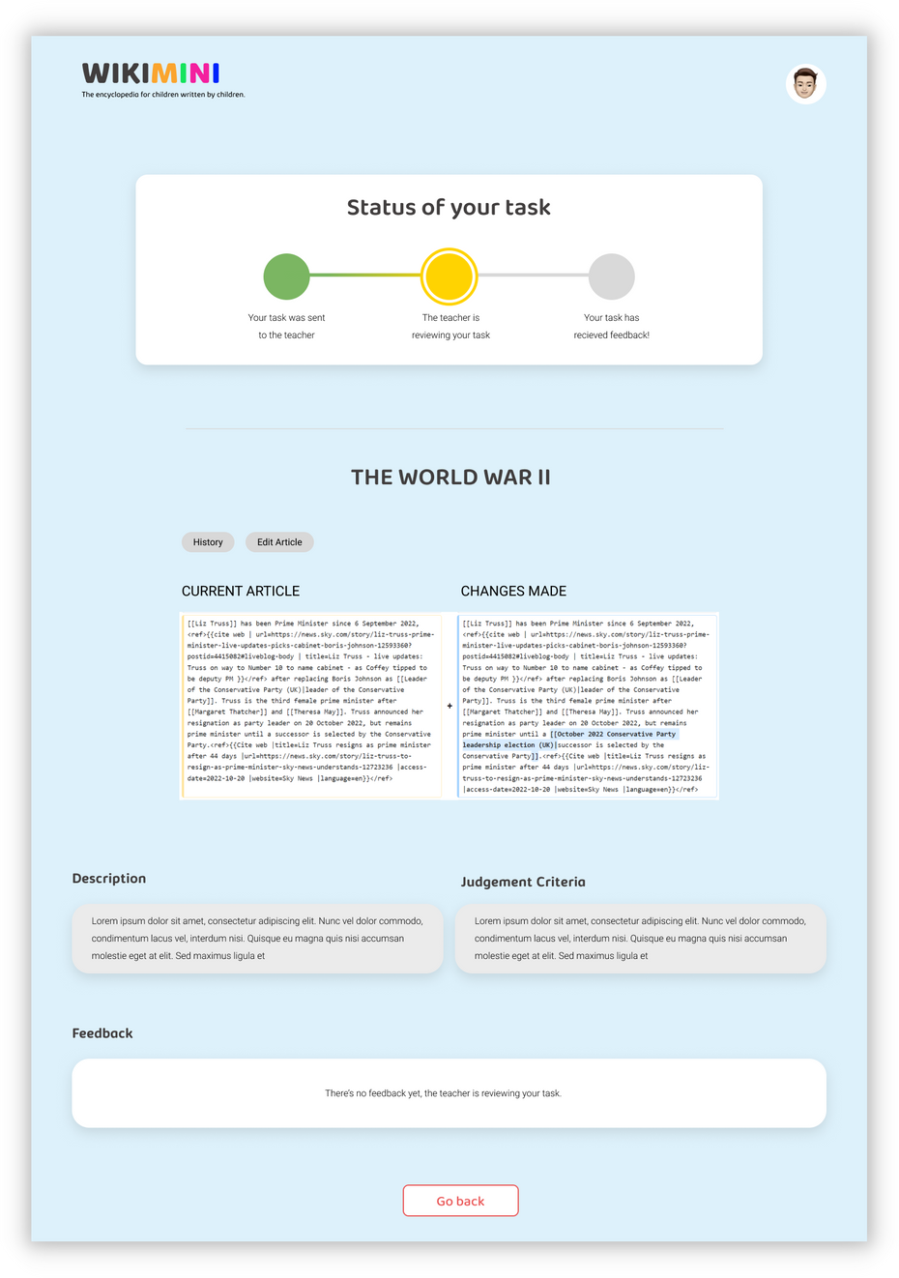
Student Workflow

Slide 24
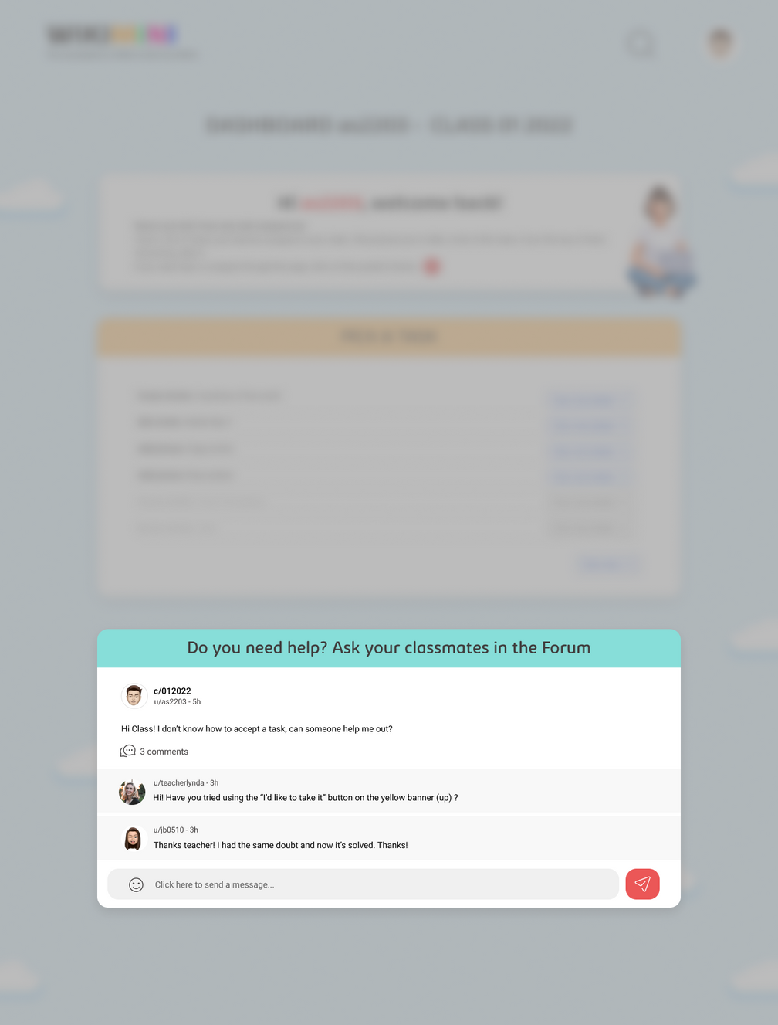
Student Workflow

Slide 25
What's new on this WikiMini 2.0?

Slide 26
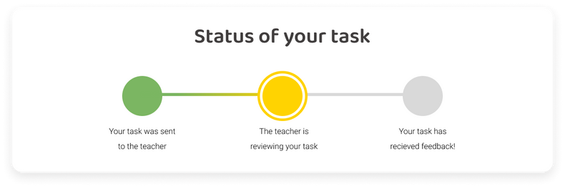


What's new on this WikiMini 2.0?
Creation of Classes
Tasks and Status
Reading Level of Articles

Slide 27

What's new on this WikiMini 2.0?
Creation of Classes
Teacher
Class 1-A
Class 1-B

Slide 28
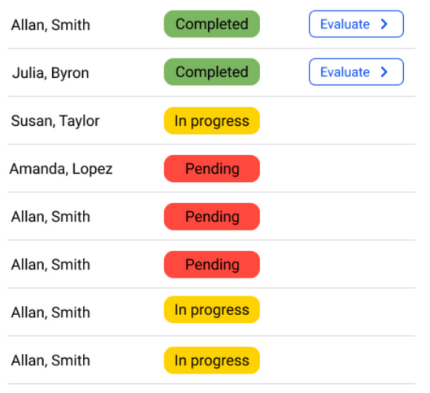
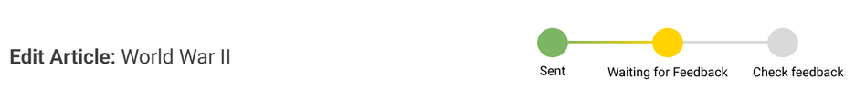
What's new on this WikiMini 2.0?
Tasks and Status

Slide 29
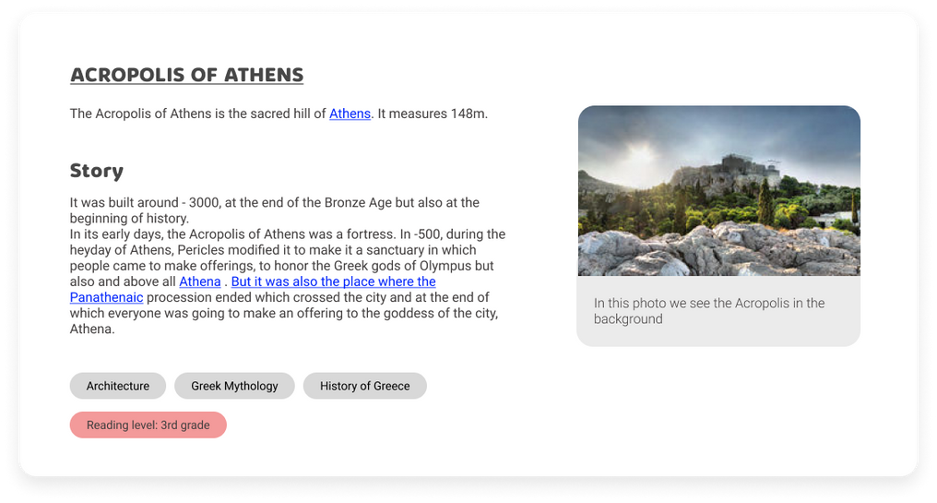
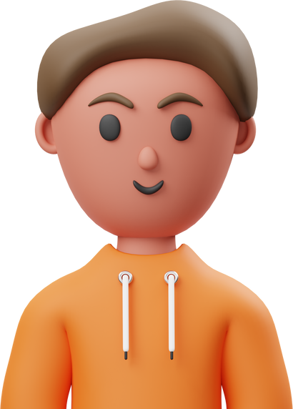
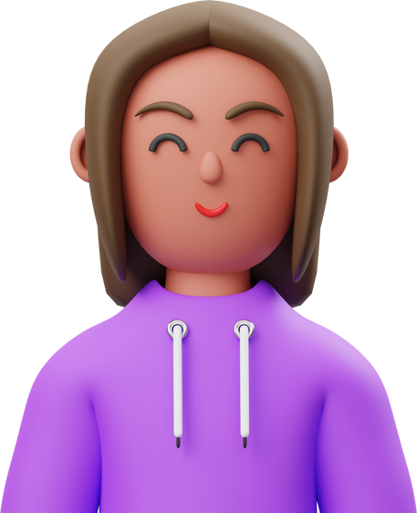

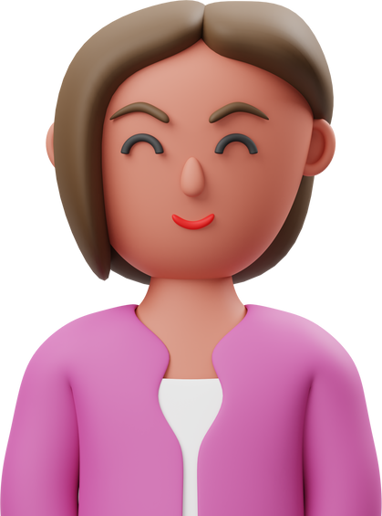
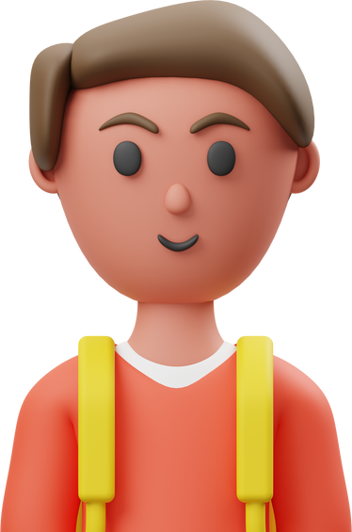
What's new on this WikiMini 2.0?
Reading Level of Articles
Fifth grade
Third to fourth grade
First to second grade

Slide 30


Thank you everybody!
THE MEDIAKIWI TEAM

